Slide 1
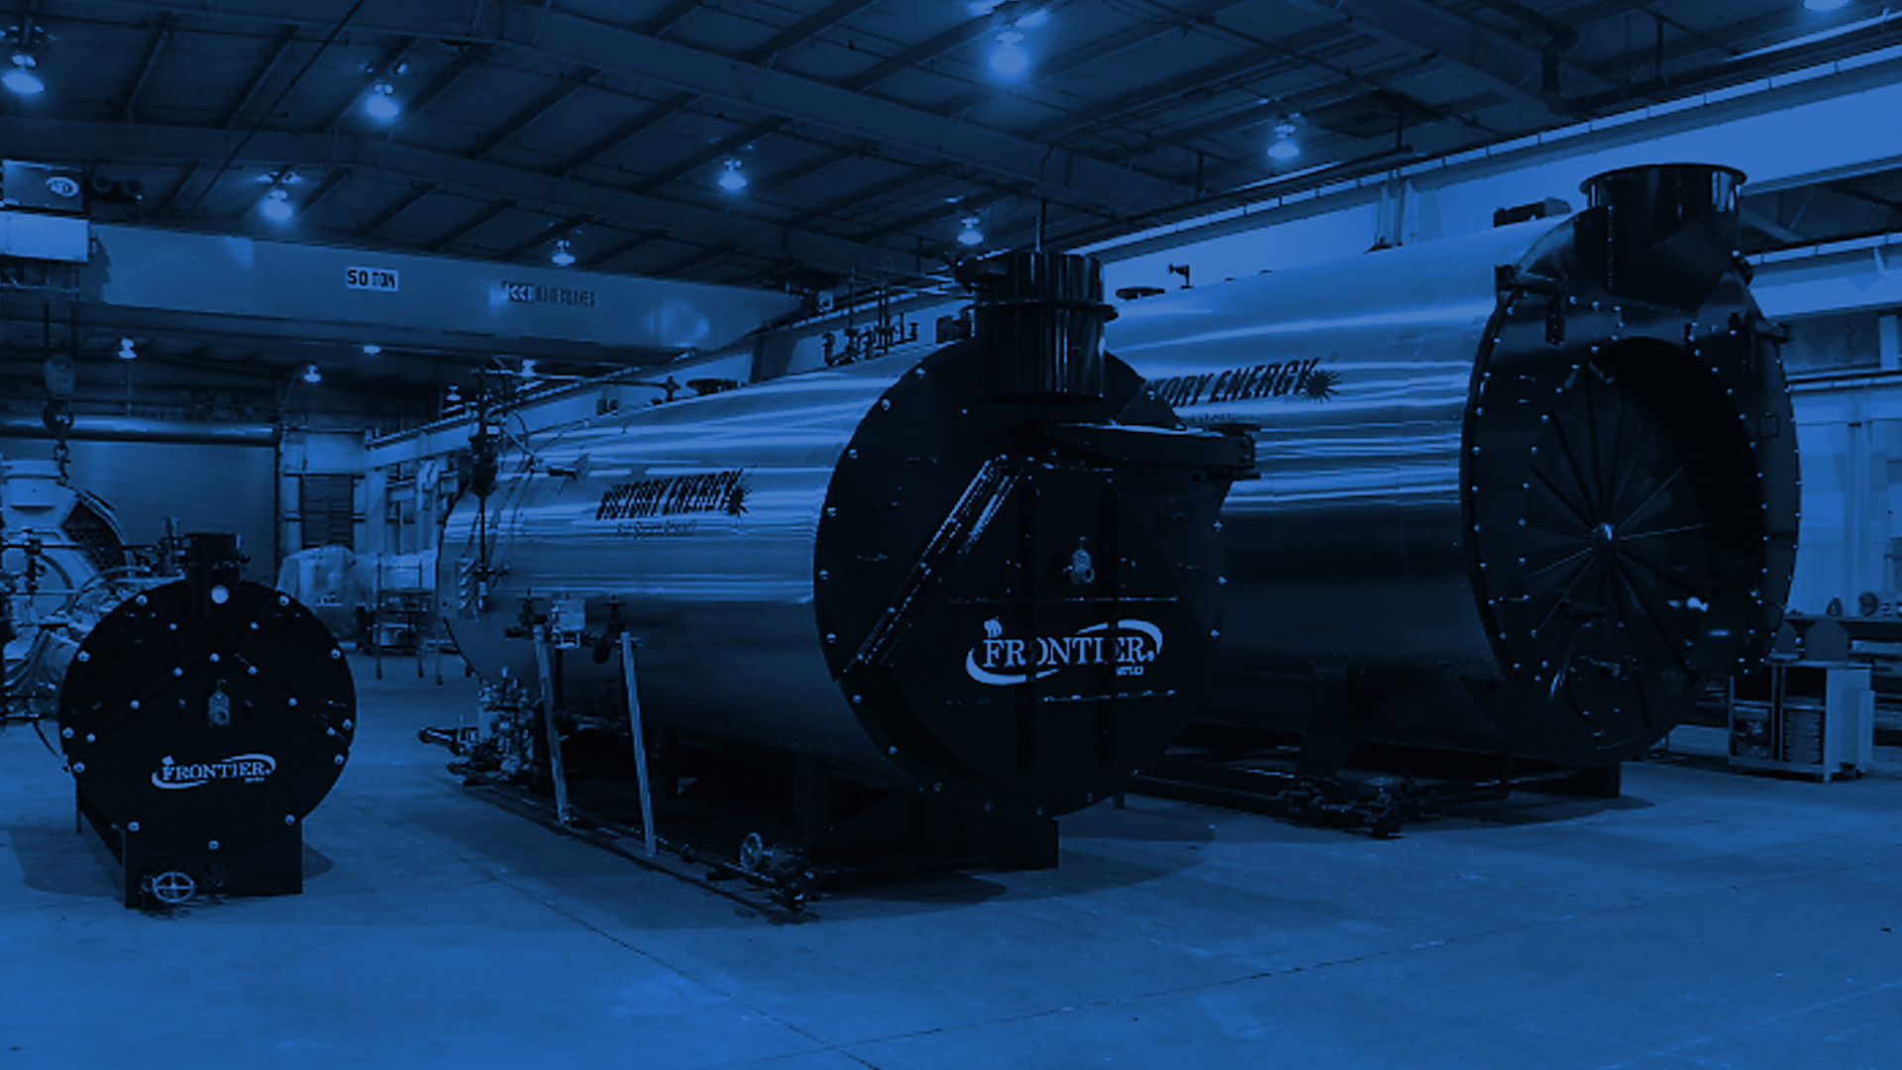
What Drives Us!
Our mission: … to provide our customers the best Boilers, Burners, HRSG’s, Heat Transfer Solutions and Services.

Slide 2
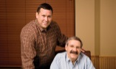
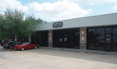
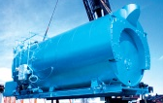
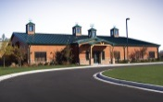
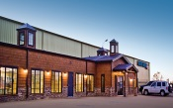
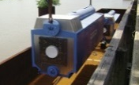
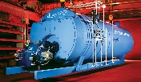
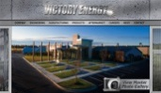
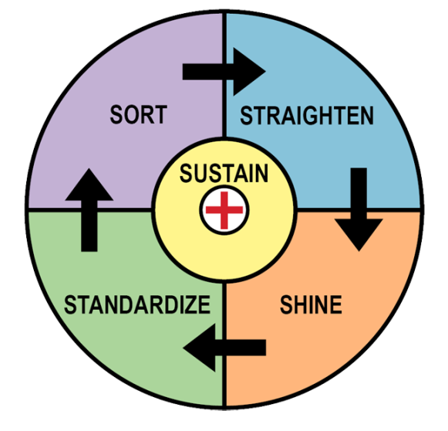
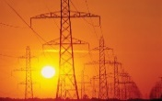
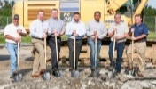
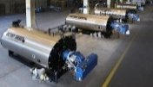
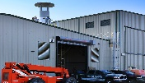
A Company Built to Last
1 9 9 9
2 0 0 0
2 0 0 1
2 0 0 3
2 0 0 4
2 0 0 5
2 0 0 6
2 0 0 7
2 0 0 8
Victory Energy Founded by John Viskup and Jim Sponder.
First Boiler Sold.
Victory Energy Relocates to its
2nd Location.
3rd VEO Location.
VEO = Firetube Wetback Boiler Rep
VEO Acquires License to Manufacture Watertube Boilers
Corporate Headquarters Completed in Collinsville, OK
Victory Energy Hires its
100th
Employee
2nd Manufacturing Facility – dedicated to Firetube boiler Production
VEO Ranked #1 Fastest Growing Manufacturer in the Nation BY Entrepreneur Magazine
1st Barge Shipment
2 0 0 9
2 0 1 0
2 0 1 2
2 0 1 3
2 0 14
2 0 1 5
2 0 1 6
2 0 1 7
New CNC tube sheet drilling machine.
Firetube Pulse Line
New Headquarters
Firetube Wetback production
VEO Launches Global Marketing Initiatives with New Website and Social Media Campaign.
Victory Energy Launches
Major GT-HRSG
Initiative
Intro Combustion Solutions
VEO Launches BoilerMACT.org Website
Manufacturing Expansion
Begins
New Boiler Steam Test Facility Complete
5S Lean Practices and Value Stream Mapping

Slide 3
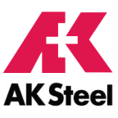
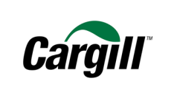
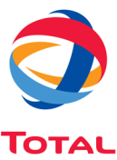
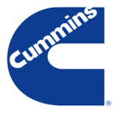
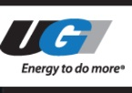
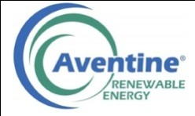
The Company We Keep
University of Colorado

Slide 4
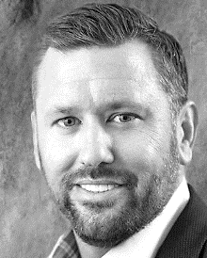
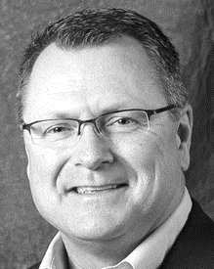
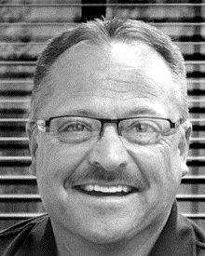
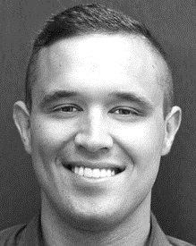
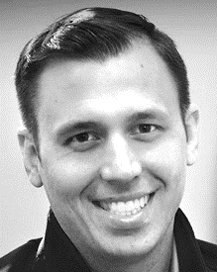
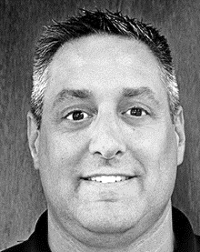
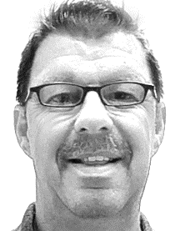
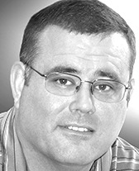
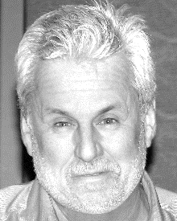
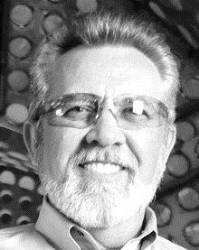
The Firetube Steam Team!
JOHN VISKUP
CEO / PRESIDENT
AL WASINGER
VP / OPERATIONS
OREN HARDESTY
NATIONAL SALES MGR – PACKAGE BOILERS
JIM ATKINSON
REGIONAL SALES MGR – FIRETUBE DIVISION
VICTOR CHAVARRIA
LATIN AMERICA SALES
CLAY VISKUP
SALES APPLICATION ENGINEER
BRANDON CHAPPELL
SALES APPLICATION ENGINEER
JAMIE WHALEN
SENIOR PROJECT MANAGER
TERRY OSBORNE
PLANT MANAGER
JEFF VANDERMAAS
DIRECTOR OF TRANSPORTATION
MORGAN MARKEY
DESIGN ENGINEER
KRISHNA PERIVILLI
DESIGN ENGINEER
BRANDON MCCOY
GRAPHIC / CAD PRODUCT SPECIALIST
BILL FIELD
MARKETING AND COMMINICATIONS
CHARLES SWALLOW
MARKETING MANAGER
JEFF ANDERSON
DIGITAL MEDIA

Slide 5
Manufacturing Facilities Equipped to Meet Market Demand

Slide 6
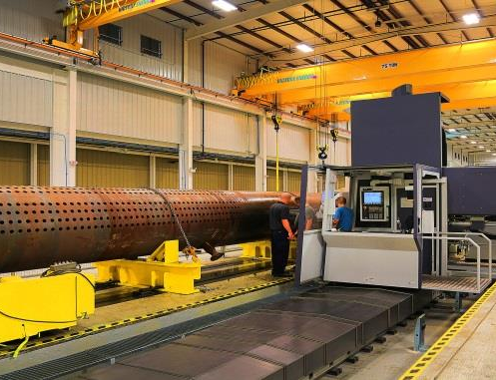
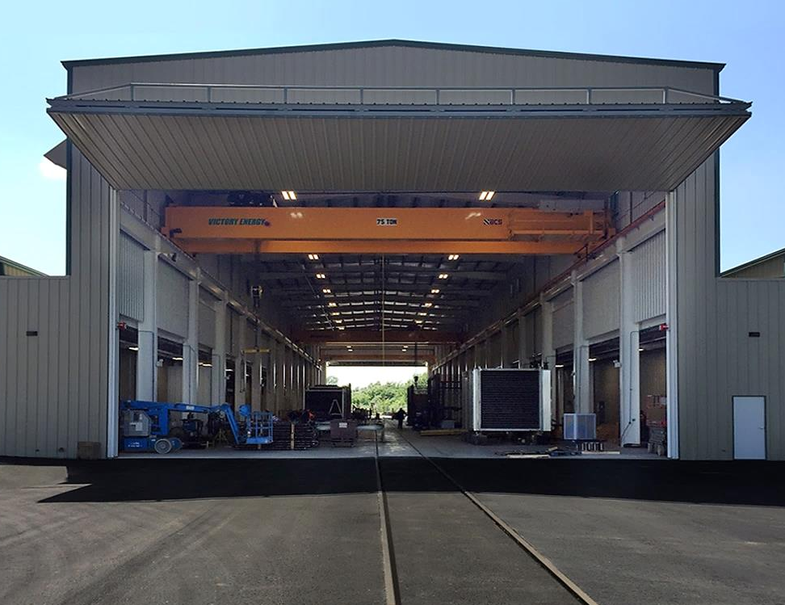
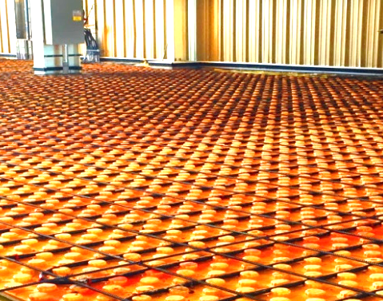
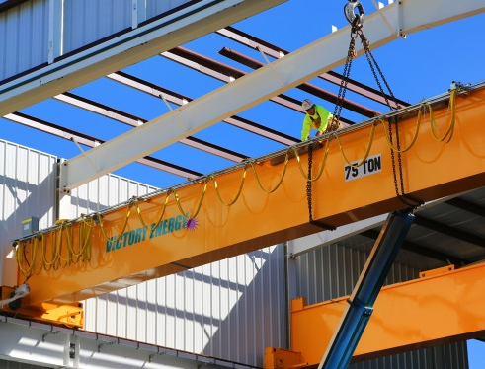
Invested in Manufacturing Efficiency

Slide 7
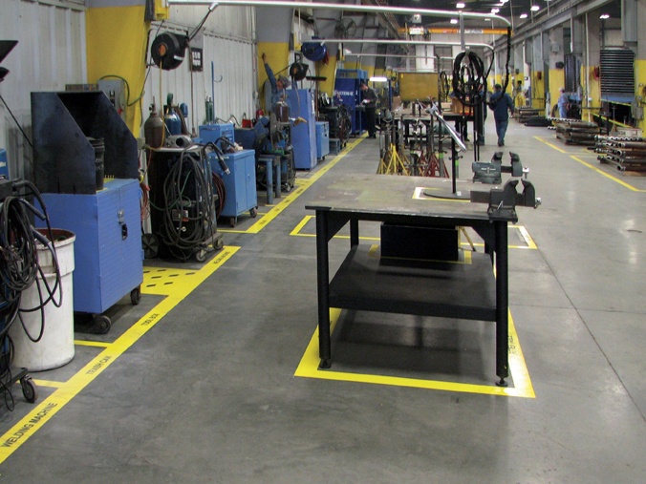
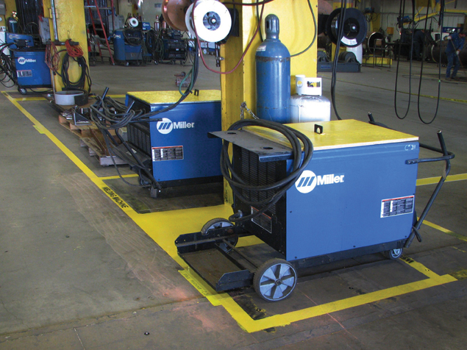
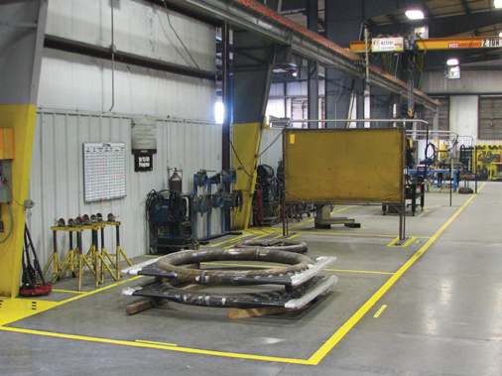
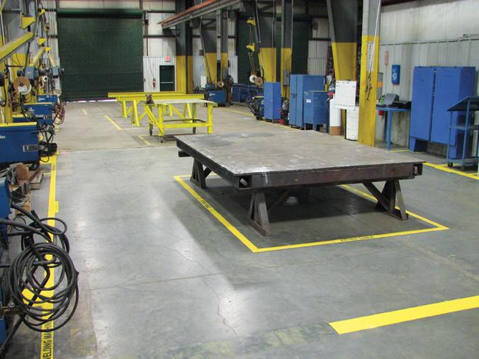
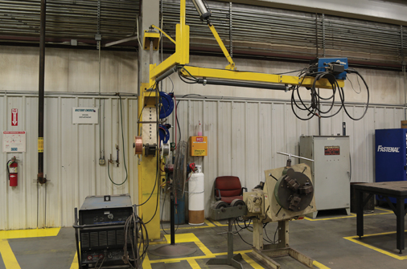
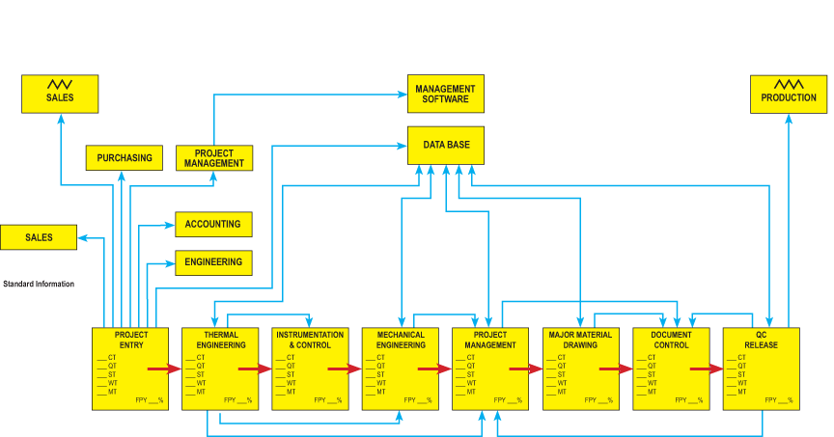
Extra Lean, Extra Clean – (5S) Lean, Not Just a Buzz Word to Us
1 - SORT
2 - STRAIGHTEN
3 - SHINE
4 - STANDARDIZE
5 - SUSTAIN

Slide 8
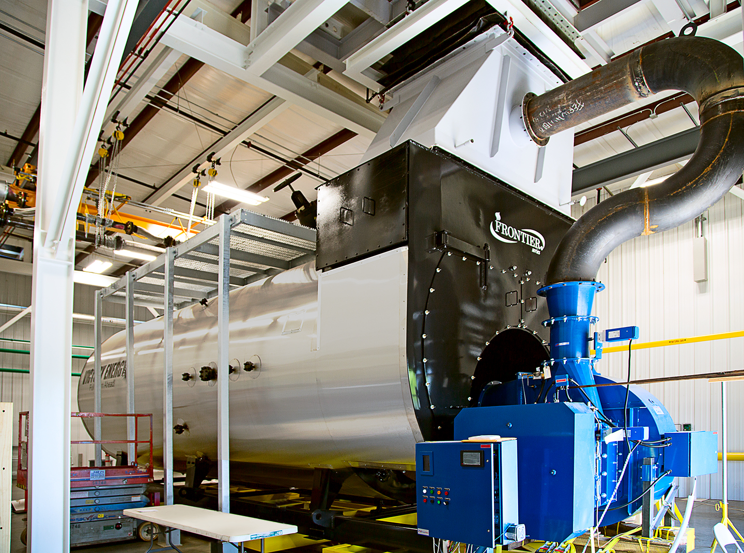
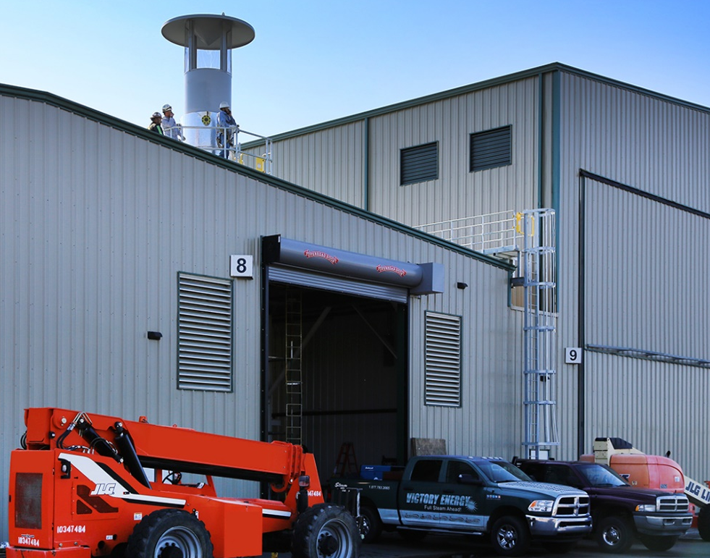
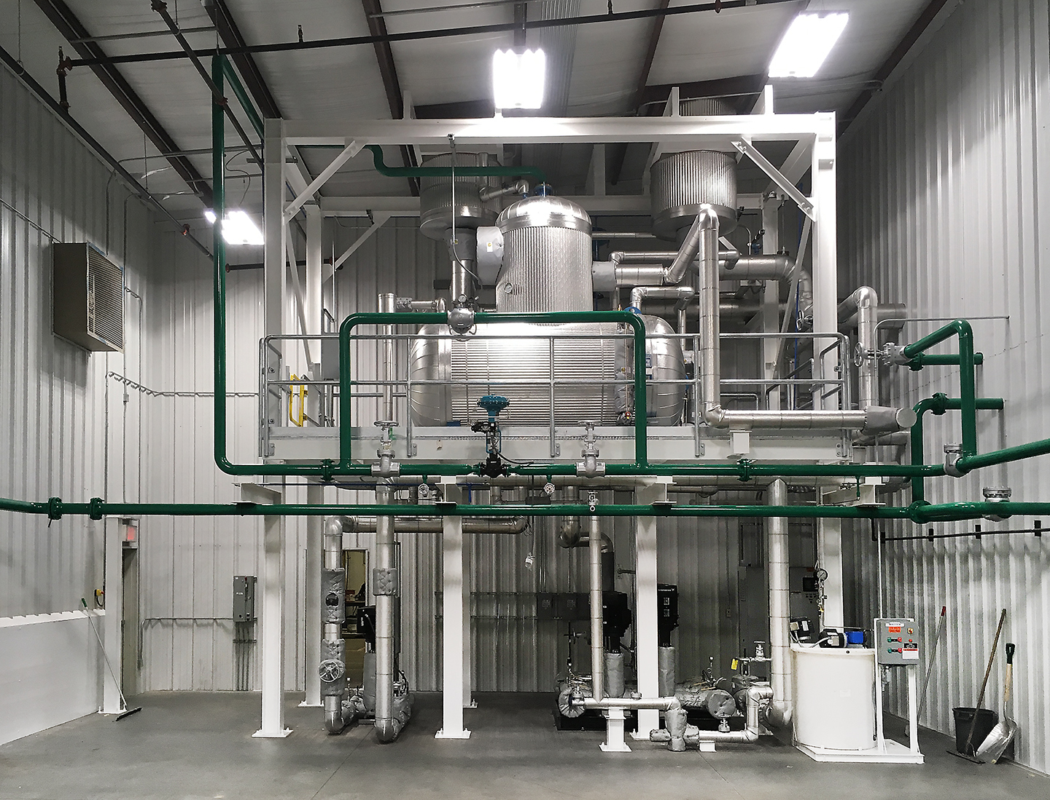
Steam Test Facility - Able to Test Up to 2,500 HP / 86,250 lbs./hr.
The Victory Energy Steam Test Facility is a true boiler industry first.
It is a fully functional steam test facility where every boiler that the company manufactures goes through rigorous operational testing prior to shipping.
6,500 Square Feet
Water Purification System
Control Room
Emission Testing

Slide 9
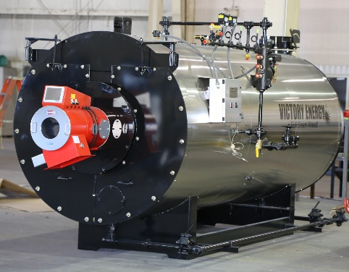
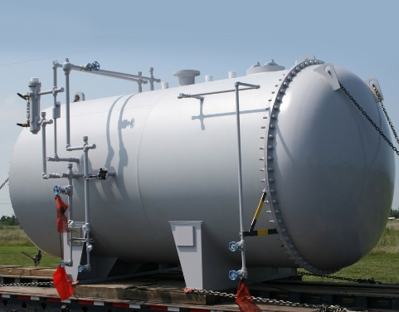
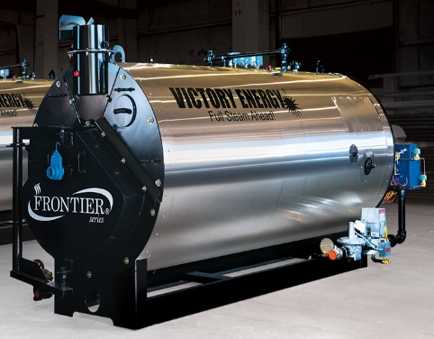
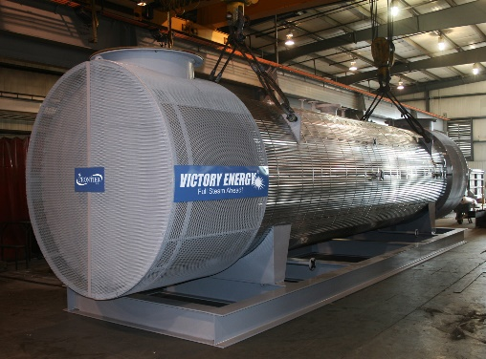
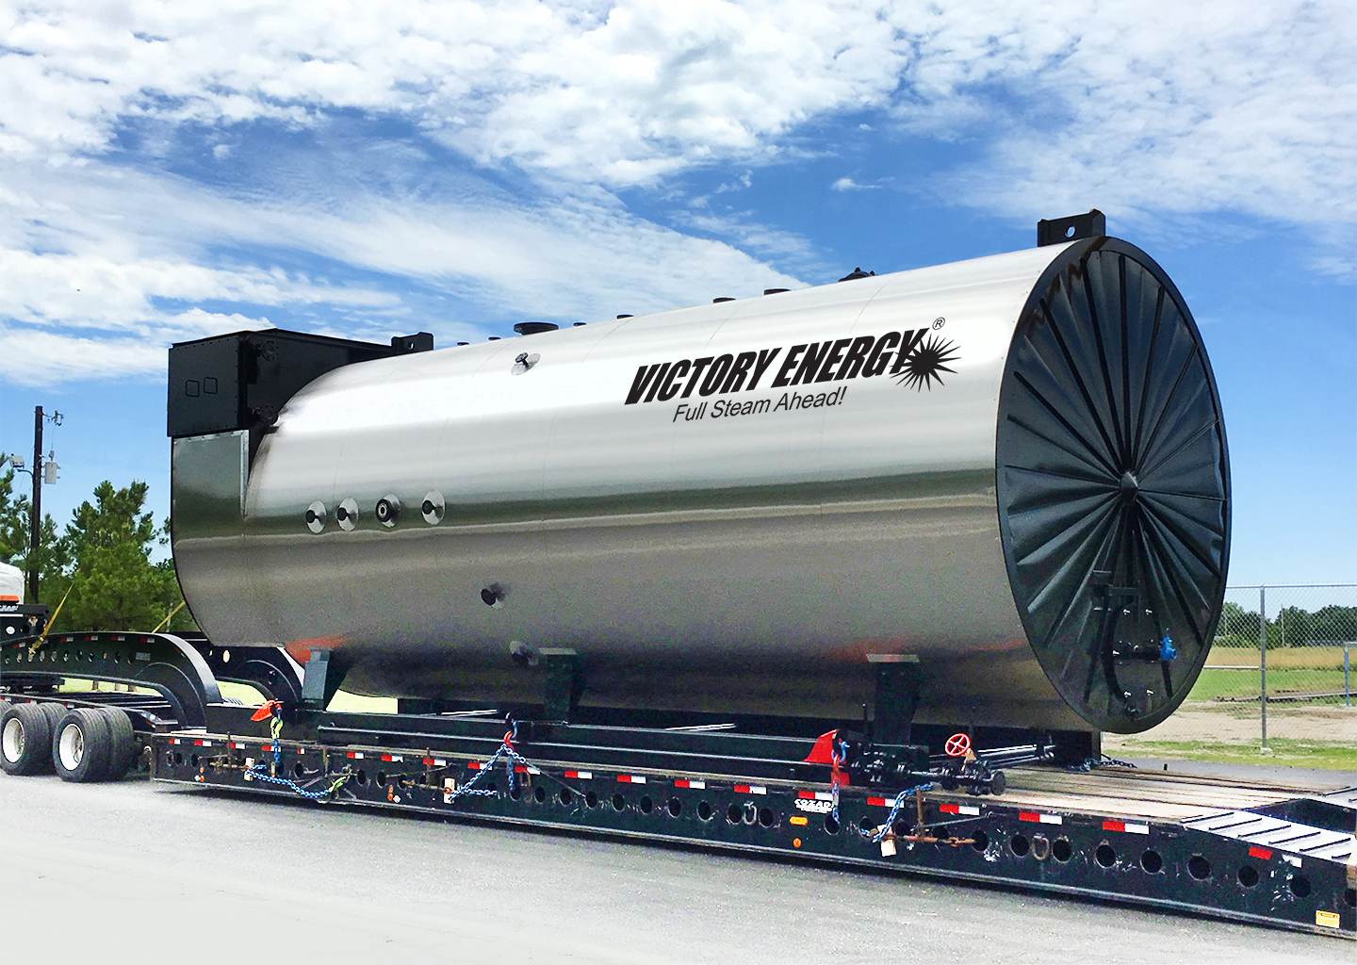
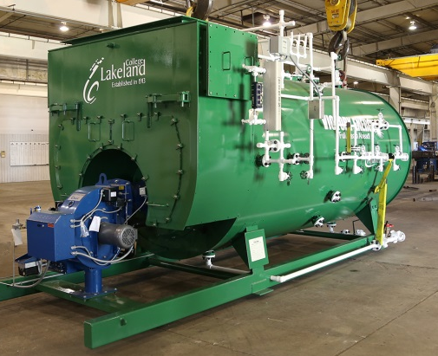
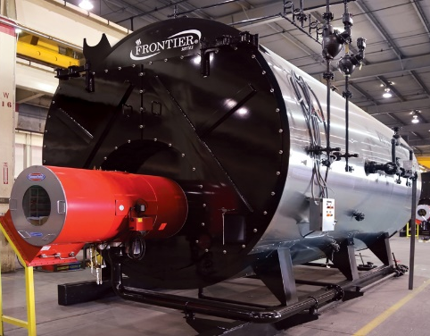
A Full Firetube Line- Fired and Heat Recovery boilers

Slide 10
Dedicated Firetube Manufacturing Facility – Cushing Oklahoma

Slide 11
VEO Pulse Line Extends Lean Manufacturing to Firetube Production.
Waste is minimized.
Emphasis on consistency and repeatability in the manufacturing processes and quality in every boiler produced.
A logical progression from order entry and engineering to final assembly where trim, burner, fuel train(s), and controls are installed and wired.
Production bottlenecks are avoided.
The result?
INDUSTRY BEST quality and lead time!

Slide 12
Pulse Line – Pre Assembly
Plasma Cutting
Plate Roll
Welding

Slide 13
Pulse Line – Pre Assembly
Furnace corrugation
Drilling tube sheet

Slide 14
Pulse Line – Pre Assembly
Furnace corrugation
The VE corrugator, which was custom-designed in-house, is capable of corrugating 1” and greater thickness furnaces.
Corrugated furnace is standard on wetback units greater than 500 HP and for design pressures 250 psi and higher.
Corrugated furnace is standard on dryback units greater than 300 HP.
Corrugated furnace can also be supplied upon customer request.

Slide 15
Pulse Line - Stage 1
Install tubesheets, furnace, coupling, manway, steam nozzle and lifting lugs.

Slide 16
Pulse Line - Stage 2
Tube install, expand, roll and bead tubes, hydro test.

Slide 17
Pulse Line - Stage 2
To make an even more robust tube-to-tubesheet connection, Victory Energy incorporates a practice more commonly utilized in the industrial watertube manufacturing process.
During pre-assembly and after the tubesheet is drilled on our CNC 5-axis mill, we add a 1/16” serration or “ring groove” on the inside of the tube hole as a final step.
When the tubes are installed, the tube ends expand into the ring groove.
RESULT is a better seated tube end and a stronger joint at the tube connection to the tubesheet with a reduced likelihood that the tubes can be loosened at this vital connection due to thermal stress or other factors.
GOAL is to eliminate the need for re-rolling, re-beading, or re-flaring of tube ends.

Slide 18
Pulse Line - Stage 3
Install front and rear door, stack and insulate.

Slide 19
Pulse Line - Stage 4
Install trim piping, mount burner / fuel train, paint and shrink wrap.

Slide 20
Pulse Line - Logistics
Boiler loadout
Shrink wrapped and ready for delivery

Slide 21
Standard Frontier Firetube Product Offerings
2-Pass Wetback With Extended Surface “Rifled” Tubes and Integral Economizer
3-Pass Wetback With Extended Surface “Rifled” Tubes in Second Pass (Integral Economizer available upon request)
3-Pass Dryback With Center Furnace (Optional Extended Surface “Rifled” Tubes in second pass available upon request)
4-Pass Wetback

Slide 22
Engineered For Extreme-Duty
Up to 2,500 HP
Up to 87,000 PPH
Up to 600 PSIG
Standard with stainless steel jacket (optional painted jacket available upon request)

Slide 23
Advanced Combustion Technology
Low Excess Air
Low NOx, Ultra Low NOx
Parallel Positioning (linkage-less) Control Systems
Maximum Efficiency and Minimum Maintenance
Heavy-duty boxed tube skid

Slide 24
Extended Surface Rifled Tubes
VEO utilizes Extended Surface Rifled tubes in the 2nd pass only, 3rd pass- and 4th pass in 4 pass units- are bare tubes.
All tubes are SA-178A-Grade.
Rifled tubes increase heating surface 23% over standard tubes.
Rifled tubes can increase efficiency 1 - 2% over standard tubes.
12 gauge tubes (.105" wall thickness + rib height = .150")
12 gauge tubes

Slide 25
Thicker Tubesheets
3/4" to 1.0" minimum thickness on tubesheets.
Thicker tubesheets promote more contact area between the tubes and tubesheets. This significantly reduces tube leaks, upon start up and over the service life of the boiler.
3/4" to 1.0" thickness

Slide 26
Wall-to-wall Super Structure
The VE tubesheet design utilizes a tube ligament design (shortest distance between tube hold edges) that is greater than competitors.
Thicker tubesheets also eliminate costly repairs such as re-rolling, re-beading or re-flaring tube ends.
Although it is more costly to use more material, the benefit is better tube sealing and longer tubesheet life.

Slide 27
Wetback Design - Highlights
Original VEO firetube product offering.
First unit manufactured in 2009.
Focus on demanding industrial users.
Stainless steel jacket is standard.

Slide 28
Wetback Design
The Frontier wetback design is characterized by three different tubesheets at the rear of the boiler for furnace and tubes attachment.
Reversal chamber from furnace to tubes is water backed; eliminating expensive maintenance and repair through the years.
No refractory issues.
2
3
1

Slide 29
Multiple Pass Designs
2-Pass
3-Pass
4-Pass

Slide 30
Enhanced Heat Recovery System
All 2-pass boilers include a shop-assembled enhanced heat recovery system which is also available for 3-pass boilers.
Low fire side pressure drop for better performance and minimal blower HP requirement.
Retains boiler footprint with minimal increase to height
Efficiency comparable or superior to 4-pass boilers without high back pressure and minimal difference in tubesheet temperatures.
Feedwater is preheated 50-70° above deaerator temperature, accelerating steam production and minimizing stress on components

Slide 31
Shared Tubesheet
Furnace and 1st pass tubes share the same tubesheet at the back.
Exposed to the same temperature zone.
Reduces risk of leaking tubes or ligament cracks.

Slide 32
Standard Wetback Features
Less prone to thermal shock.
Less standby losses from rear door.
Less rear door swing requirements.
Refractory is eliminated in doors and smoke box areas.
Front and rear davit type doors
Reinforced sheet metal skin provides durable and long- lasting cover for rear insulation

Slide 33
Additional Standard Wetback Features
The Frontier Wetback Series does not use couplings in water or blowdown piping.
All joints are slip-on flanges.
Elbows and T's are socket welded for the Wetback series.
Crosses have nipples and caps for cleaning access.

Slide 34
24-inch Rear Fireside Access
A true, full-sized fireside “manway”
Industrial quality sight glass assembly
Hinge and davit allows fast opening and closing, minimizing down time.
Manway design + split front and rear davited door minimizes manpower and equipment requirements when periodic maintenance is required.

Slide 35
3-Pass Dryback Firetube Series
Designed to optimize water circulation
Unrestricted water circulation
Non-dissolved solids fall to bottom
Easily flushed
Engineered for long-term performance
Centerline furnace design incorporates two tube sheets and a centrally located furnace achieving uniform stress with minimal difference in tube sheet temperatures
Centerline furnace design also allows for smaller back door - easier to open and close for maintenance, eliminates refractory bridge which is costly to maintain.

Slide 36
3-Pass Dryback Firetube Series
NOTE: 2-Pass Design, “Rifled” Tubes, and Integral Economizer are available upon request.

Slide 37
3-Pass Dryback Firetube Series
Centerline furnace benefits
Ample distance from burner centerline to floor to accommodate virtually all types of burner designs
Allows even distribution of heat in the rear tube sheet
Likewise rear refractory does not see large temperature differentials
Promotes excellent water circulation, minimizing thermal shock related concerns.

Slide 38
3-Pass Dryback Firetube Series
Victory designed hinge and davit assembly
Includes bearings for years of reliable and safe operation when opening for cleaning, maintenance, and inspection
designed so that only minimal manpower and no additional equipment is needed
Rear door assembly includes superior quality refractory material
Special refractory has an expansion modulus of 0.00, from ambient to 3,000+ degrees
Virtually impervious to expansion-related stress cracking
No bridge or arch which is a common failure point on competitors’ dryback designs

Slide 39
Waste Heat Recovery (HRSG)
Our experienced and talented engineering team stands ready to meet your specific needs!

Slide 40
Why you should consider Victory Energy
We are a forward-thinking, innovative company that is not shackled to the old ways of doing things. You won’t hear “…because that’s the way we’ve always done it” from us!
We bring the engineering expertise and “can do” spirit that is vital to conducting business in the industrial market to the firetube boiler business
We challenge anyone to compare our facilities and craftsmen with others. Visitors are welcome anytime! We guarantee that you will leave impressed.
is not just a catchy phrase. We take it very seriously.
How important is the longevity of your purchase?
How important is less costly maintenance and minimal downtime to your facility?

Slide 41
Follow A Leader

